Slide 1
The Finnish Open Science and research initiative and development of green open access in finland
Pekka Olsbo
Head of Publishing, University of Jyväskylä
Bratislava 19.10.2016

Slide 2
Introduction
Speaker: - Working with open access since 1997 and last years as a developer of open science in the University of Jyväskylä. - Several national projects and working groups, now the leader of ”Finland – a model country for green open access” project.
University of Jyväskylä - 15 000 students, 2500 staff, multidisciplinary university with 7 faculties. - A forerunner in open science development in Finland.

Slide 3
EU demands Open Access
On the 27th of May 2016 EU leaders announced an initiative which asserts that European scientific papers should be made freely available to all by 2020.
http://english.eu2016.nl/documents/press-releases/2016/05/27/all-european-scientific-articles-to-be-freely-accessible-by-2020
This is a result of a development that we all have known already for years. In Finland we have tried to get ready for this.

Slide 4
Open Science and Research in Finland
Open Science and Research Initiative 2014-2017
Ministry of Education and Culture initiative for the promotion of information availability and open science
Goal to make Finland a leading country in openness of science and research
Scope includes publications, research data, and methods
Provides researchers with practical knowledge in how they as individuals can implement open science
Several services offered by the Ministry to researchers www.openscience.fi

Slide 5
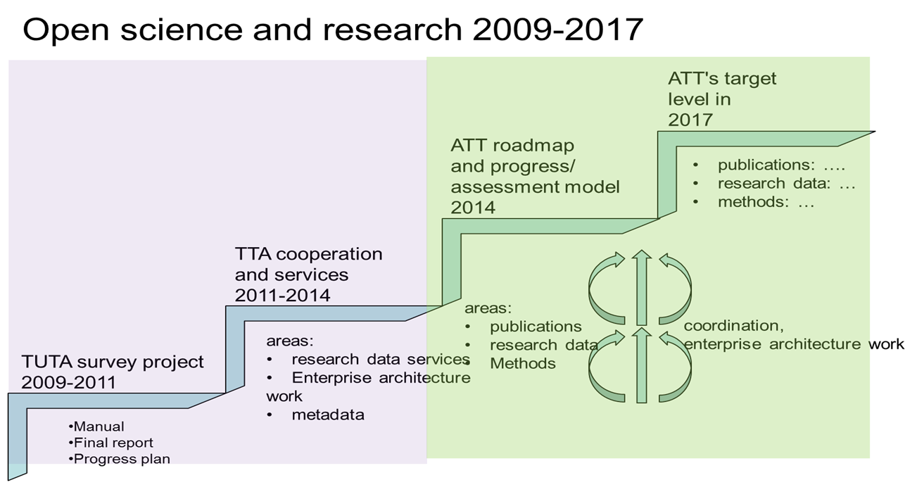

Slide 6
Open Science and Research vision
Vision 2017:
Open research leads to surprising discoveries and creative insights
Reinforcing the intrinsic nature of science and research
Strenthening openness-related expertise
Ensuring a stable foundation for the research process
Increasing the social impact of research

Slide 7
Vision opened
Reinforcing the intrinsic nature of science and research. Openness and repeatability increase the reliability and quality of science and research.
Strengthening openness-related expertise. Those working within the Finnish research system know how to harness the opportunities afforded by openness to boost Finland’s competitive edge.
Ensuring a stable foundation for the research process. Good and clear basic structures and services enable new opportunities of openness to be harnessed in a timely manner and ensure a stable basis for research.
Increasing the social impact of research. Open science and research creates new opportunities for researchers, decision-makers, business, public bodies and citizens.

Slide 8
Open Science and Research Roadmap 2014-2017
On 25th November 2014, the Ministry of Education and Culture of Finland released The Open Science and Research Roadmap 2014–2017.
The vision "Open research leads to surprising discoveries and creative insights” explained in more details.
As a result of this roadmap “Information flow is facilitated by clear policies and best practices, and by providing services to safeguard the availability of scientific and research results… and openness has given Finnish research an international competitive edge.”

Slide 9
Initiative collaboration structure
The Open Science and Research Initiative is based on a broad-based cooperation between ministries, universities, research institutions and research funders such as the Academy of Finland and TEKES - the Finnish Funding Agency for Innovation, Finnish Social Data Archive (FSD), National Library of Finland, Federation of Finnish Learned Societies, FinnOA-the Finnish Open Access Working Group, CSC - IT Center for Science Ltd.

Slide 10
Initiative collaboration structure
Open science and research forum
convenes annually in the autumn
Strategy group with members from universities, polytechnics,
research institutes, ministries, funding bodies, etc.
Expert group
Workshops and targeted surveys
Special working
groups
Service
providers
Management of the
enterprise architecture

Slide 11
Open Science and Research services
Etsin research data finder
IDA research data storage
AVAA open data publishing platform
Aila data service portal
Language Bank of Finland
Doria & Theseus publication archives
FINTO ontology service
http://openscience.fi/services
Open Science and Research Handbook
Data management guide and checklist

Slide 12
FINLAND – a model country for Green Open Access
Project funded by the Ministry of Education and Culture and The Open Science and Research Initiative.
A joint project with the University of Jyväskylä and University of Eastern Finland.
Aim is to lift the green OA activity in Finland to international top level.
Create a general model for self-archiving and centralized open science services

Slide 13
Project task-list
Create services and information systems that support open publishing services of universities.
Create a service model for practicing self-archiving as easy as possible.
Process model will combine reporting of research information and self-archiving to one cost-effective and unified process.
Ensure the interoperability of current research information systems (CRIS) and institutional repositories.
Implement open licenses to repositories.
Research upon open publishing.

Slide 14
The Process of Self-archiving (green OA)

Slide 15
Results of the Project: Development of green open access in Finland
Number of archived OA articles in 5 Finnish repositories 2010-2016

Slide 16
Results of the Project: Development of green open access in Finland
During the Project the number of articles in Finnish repositories has tripled.
But still the share of articles deposited is very low in all Finnish universities – with one exception – the University of Jyväskylä.
Most of the deposited articles are born open access – copies of publisher pdf:s from open access journals. Only in University of Jyväskylä the share of final drafts is almost equal to publisher pdf:s
The process of self-archiving is not working the way it should – except in Jyväskylä.

Slide 17
The share of deposited articles in university´s own repository vs articles published 2015

Slide 18
Publisher pdf:s, final drafts and pre prints in 4 Finnish repositories

Slide 19
Open Access in the University of Jyväskylä
http://openaccess.jyu.fi
University of Jyväskylä is the number 1 open access publisher in Finland – others won´t come even close!
Centralized services and processes for practicing OA.
University Library is the key player and takes care of self-archiving and population of CRIS.
Repository JYX among the best repositories in EU.

Slide 20
Growth of open access in University of Jyväskylä 2015-2016

Slide 21
Growth of Green open access of peer reviewed articles

Slide 22
Best practices for self-archiving
Support from the administration is essential – strong mandate.
Centralized services for practicing self-archiving – researchers do not have to do it themselves.
Centralized services for maintaining and populating CRIS – library staff are specialists.
Take good care of metadata!
Interoperability of CRIS and repository is very important.
Constant communication with researchers, faculties and administration.
Make open access and its benefits visible

Slide 23
Thank You
pekka.olsbo@jyu.fi
+358 505818355
www.jyu.fi
openaccess.jyu.fi

